Slide 1

Linker
v
Presented by Team HETI
07/05/2024

Slide 2



What and Why
Linker = LinkedIn + Tinder
Connects Companies and Job-seekers
Relies on Premium Subscriptions and Ads

Slide 3
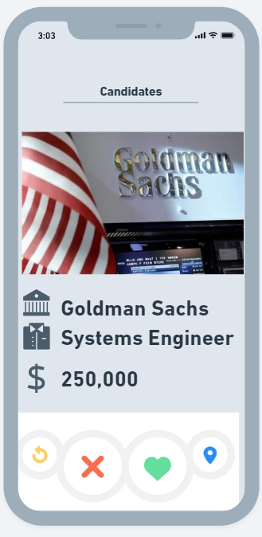
Synopsis
Linker = LinkedIn + Tinder
Tinder Streamlines the Process of matching with partners
We plan to use the same concept except for Companies and Job-seekers

Slide 4
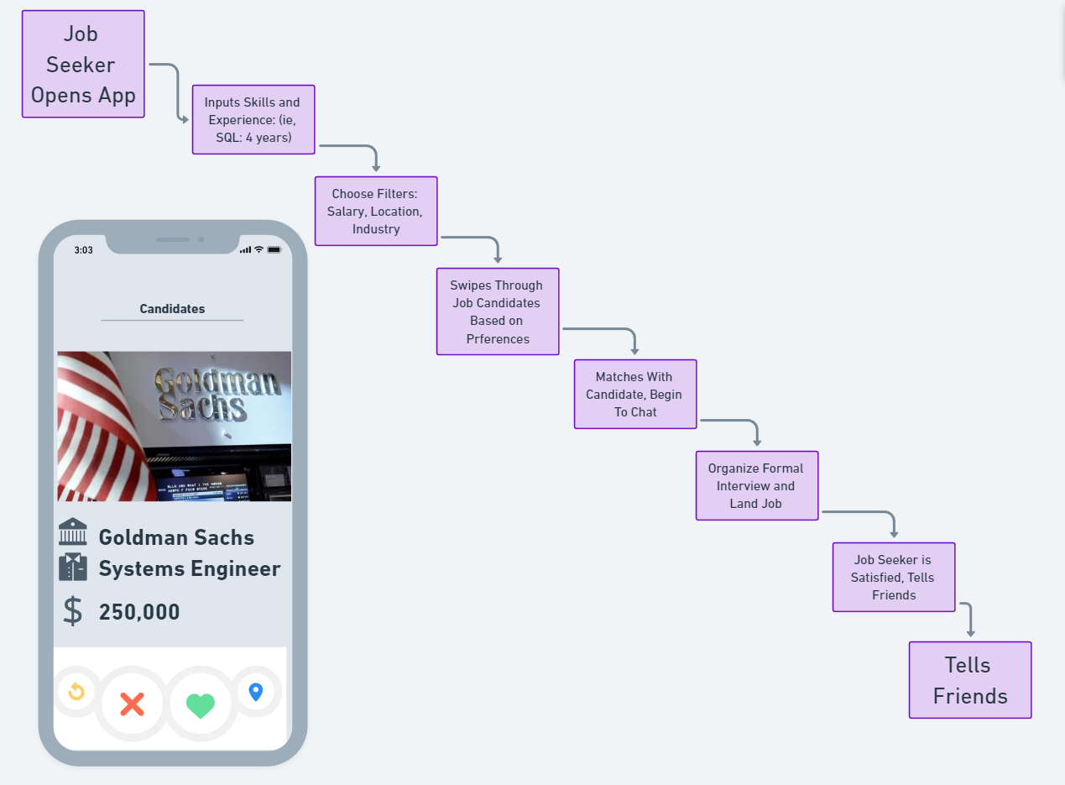
User Journey
For both employers and job seekers.

Slide 5
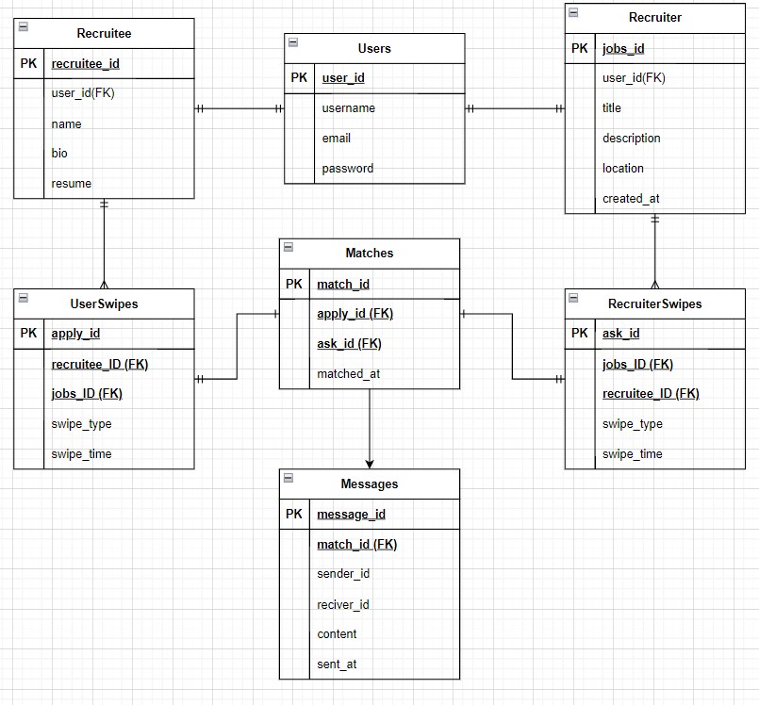
The Data

Slide 6




The Stack
Back End
Node.js for its ability to handle concurrent connections with high performance and scalability due to its non-blocking, event-driven architecture.
Flask for developing lightweight and scalable web applications and APIs, offering simplicity and flexibility through its minimalistic, modular design in Python.
Front End
React.js is widely used for frontend development because of its popularity and the advantage of reusable components.
Database
MySQL is used as a relational database management system to efficiently store, manage, and retrieve data for web applications and various other software applications.

Slide 7
Member Roles
Ibrahim Rahat
Backend and assisting database
Tehseen Chowdhury
Database and assisting backend
Haris Khan
Frontend and backend
Elly Honig
Backend and system design
Peijian Huang
Frontend development and UI design

Slide 8
Q&A

